Slide 1
Machine Learning
Machine Learning Introduction to Machine Learning by Kumar Anurupam is licensed under a Creative Commons Attribution-4.0 International License.
Regression – Regularization
CS 3104 Fall 2019
Lecture Slides by Kumar Anurupam

Slide 2
Learning Outcome
After the completion of today’s session you will be able to:
Explain the concept of regularization.
Illustrate how ridge and lasso regression helps in regularization.

Slide 3
The Problem of Overfitting [1]
Overfitting is one of a major concern while training our Machine Learning model.
The model will have a low accuracy if it is overfitting. This happens because your model is trying too hard to capture the noise in your training dataset.
By noise we mean the data points that don’t really represent the true properties of your data, but random chance.
Learning such data points, makes your model more flexible, at the risk of overfitting.
Regularization can be an answer to overcome this problem.

Slide 4
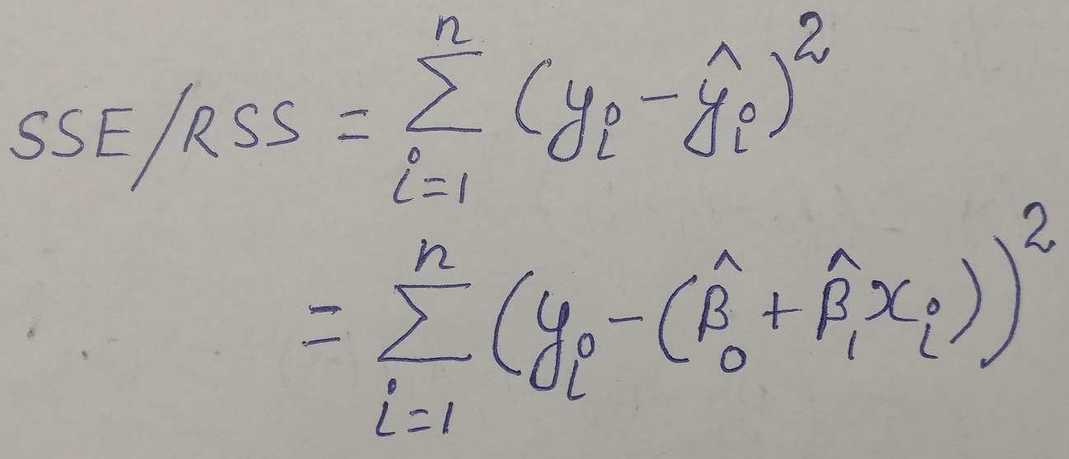
Regularization
This is a form of regression, that constrains/ regularizes or shrinks the coefficient estimates towards zero.
This technique discourages learning a more complex or flexible model, so as to avoid the risk of overfitting.
The fitting procedure involves a loss function, known as residual sum of squares or RSS or SSE. The coefficients are chosen, such that they minimize this loss function.

Slide 5
Regularization – contd…
Now, this will adjust the coefficients based on your training data. If there is noise in the training data, then the estimated coefficients won’t generalize well to the future data.
This is where regularization comes in and shrinks or regularizes these learned estimates towards zero.
The Ridge Regression can be used to implement regularization.

Slide 6


Ridge Regression - Regularization
Ridge regression can be analyzed by the following equation:
Where:
This part of the equation adds a penalty to the traditional least square method.
determines how severe the penalty is. Its value lies between 0 to positive infinity.
The increase in flexibility of a model is represented by increase in its coefficients, and if we want to minimize the above function, then these coefficients need to be small.
This is how the Ridge regression technique prevents coefficients from rising too high. Also, notice that we shrink the estimated association of each variable with the response, except the intercept β0.
Selecting a good value of λ is critical. Cross validation comes in handy for this purpose.
The coefficient estimates produced by this method are also known as the L2 norm.

Slide 7

lasso Regression - Regularization
lasso regression can be analyzed by the following equation:
Its clear that this variation differs from ridge regression only in penalizing the high coefficients.
It uses |βj|(modulus)instead of squares of β, as its penalty. In statistics, this is known as the L1 norm.

Slide 8
Summary
Regularization can be used to overcome the problem of overfitting.
Penalty can be added and with some severity to reduce the problem of overfitting.

Slide 9
References
[1] https://towardsdatascience.com/regularization-in-machine-learning-76441ddcf99a

Slide 10
Thanks

